Slide 1

UC Ready
Level 1: Overview of Resiliency Processes
UC Santa Cruz, Office of Emergency Services

Slide 2
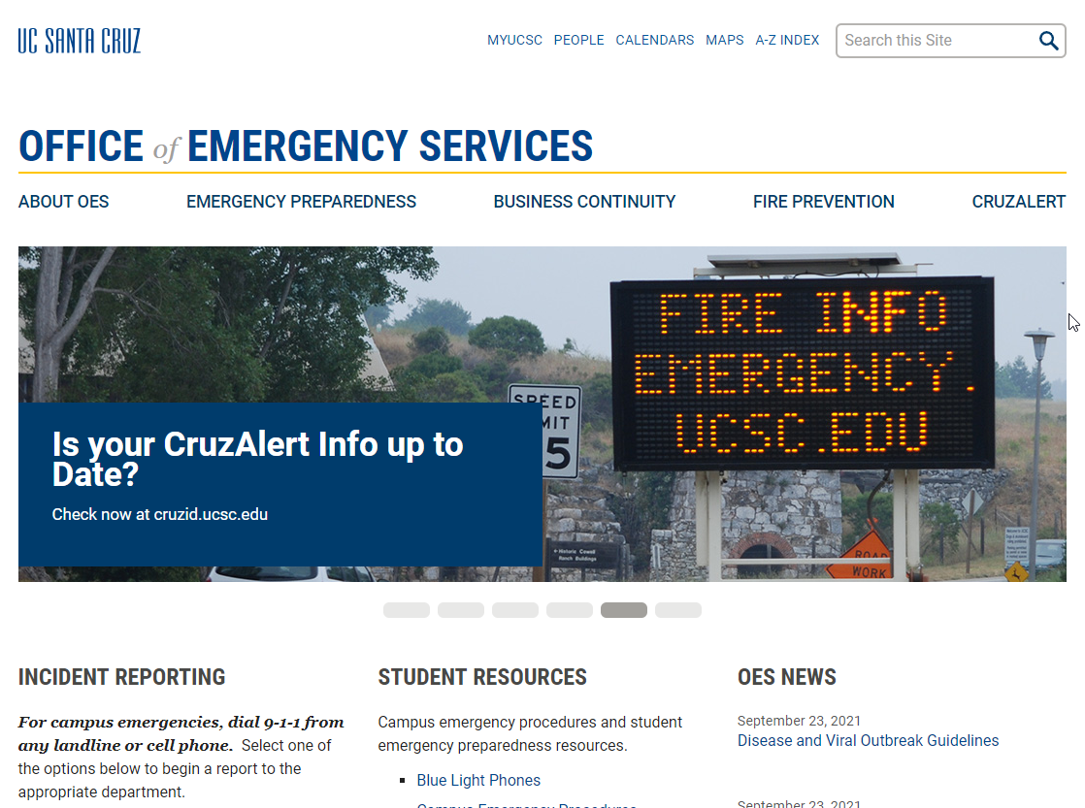
Login to UC Ready: oes.ucsc.edu
Notes:
https://oes.ucsc.edu/

Slide 3
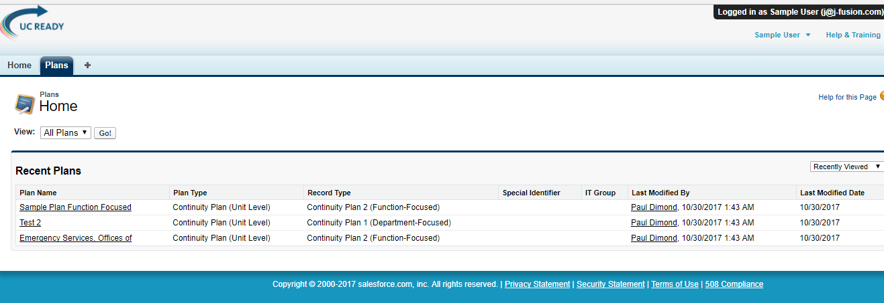
1. PLANS
2. GO
3. Locate plan, select EDIT
To Locate and Open Your Plan
Notes:
https://oes.ucsc.edu/

Slide 4
UC Ready: Level I
Overview of Resiliency Planning Process
Phase I (Risks and Essential Functions)
UC Ready User Manual
UC Ready Software
Notes:
Why are you here today?
Overview – what’s changed (Addition of UC Ready Annex, BEC, UC Ready)
Phase I: THIRA – that is the Threat, Hazard Identification and Risk Assessment Process, Business Impact Analysis, Identification and prioritization of your Essential functions
Resumption Annex (binder)
And finally, we will test drive UC Ready

Slide 5
Terminology
Business Continuity: Is a systematic interdisciplinary approach to planning for how the campus will continue to provide critical operations and business functions during and after a disaster. Such planning is a crucial part of the larger integrated UC Santa Cruz Emergency Management program which focuses on mitigation, preparedness, response and recovery planning activities.
Risk: An organization’s vulnerability to hazards, including natural disasters and human-caused incidents that pose a threat to facilities or personnel.
Mitigation: Eliminating or minimizing hazards that may result in a major emergency.
Essential Functions: Are those organizational operations that are critical to the sustainability of the institution. They are required to be performed during and following a disruption to provide safety and health to the business community, to continue vital services, maintain compliance, preserve research and resources, and sustain the economic base of the institution.
Business Resilience: Is the ability of an organization to quickly adapt to disruptions while maintaining continuous business operations and safeguarding people and assets.
Recovery: Returning to a level of normalcy after an emergency has occurred.
Business Resumption: Addresses restoration of your business after an emergency and focuses on preventative measures.
Notes:
Commonly Used Terms in Business Continuity Planning.
I will elaborate more during this presentation on the functionality, operability, and what these terms mean to you in your planning process.

Slide 6
Business Resiliency
Having a plan for disaster response and business recovery.
Emergency Management
“The managerial function charged with creating the framework within which communities reduce vulnerability to hazards and cope with disasters. Vision. Emergency management seeks to promote safer, less vulnerable communities with the capacity to cope with hazards and disasters.” FEMA
Business Continuity Management
“The process of ensuring that your critical business functions are prepared to react to and recover from a business disruption with minimal amount of impact to your business.“ Iowa University
THINK LONG TERM
Notes:
The two components to Resiliency planning are: emergency management and business continuity management.
As you complete your plans, please consider these two processes really support each other, and one without the other is in itself a recipe for a disaster. Often departments put more attention into getting their Emergency Management Plans done, and put off the Business Continuity Planning. Which is kind of ironic because emergency events are typically over in a few hours, whereas business recovery events can go on for weeks or months! And if planned poorly, could be excruciating expensive, delayed and harmful to an institution’s reputation.

Slide 7
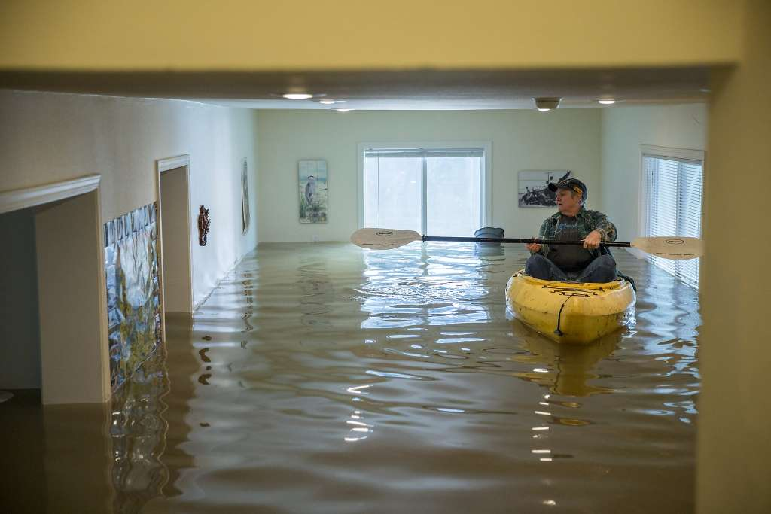
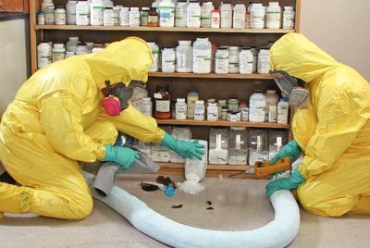

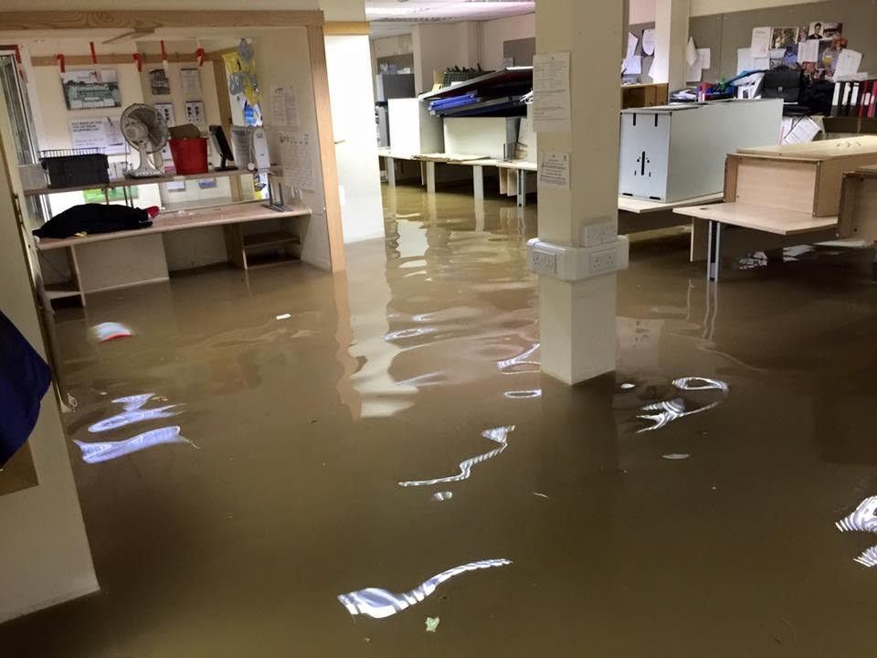
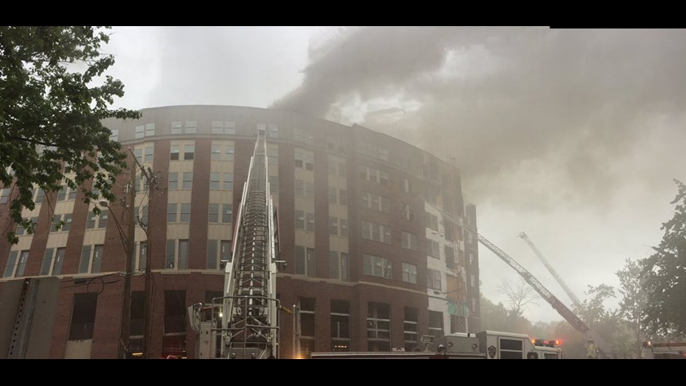
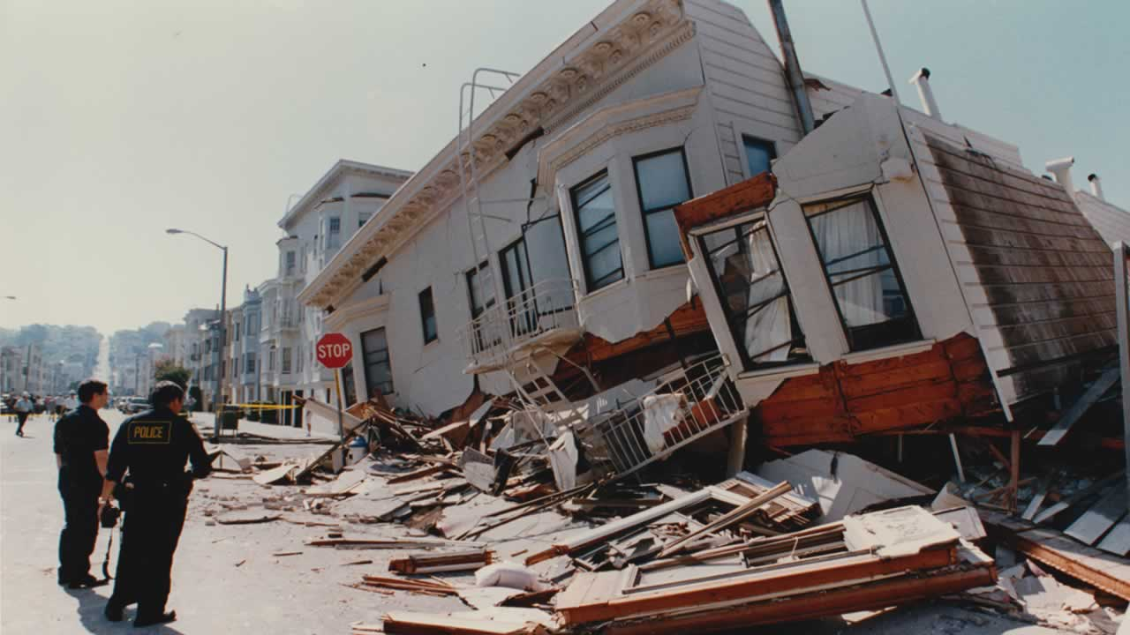
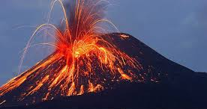
Resiliency Planning, what’s it all About?
Notes:
Various types of disasters…
Before the disaster, we plan so that we can provide answers to the following questions:
Would our employees feel prepared to respond if a critical event?
Would everyone know our evacuation and assembly procedures?
Would everyone have their data backed up and would they grab their laptops?
Would we have a relocation team ready to resumption our operations at an alternative location?
Would we have pre=identified our most critical functions…..and prioritized them?
Would we have a list of required resources and vendor contacts to resume our most critical operations?
Would we have a communication plan to keep our employees in the loop?
Who is in charge of all of this!?

Slide 8
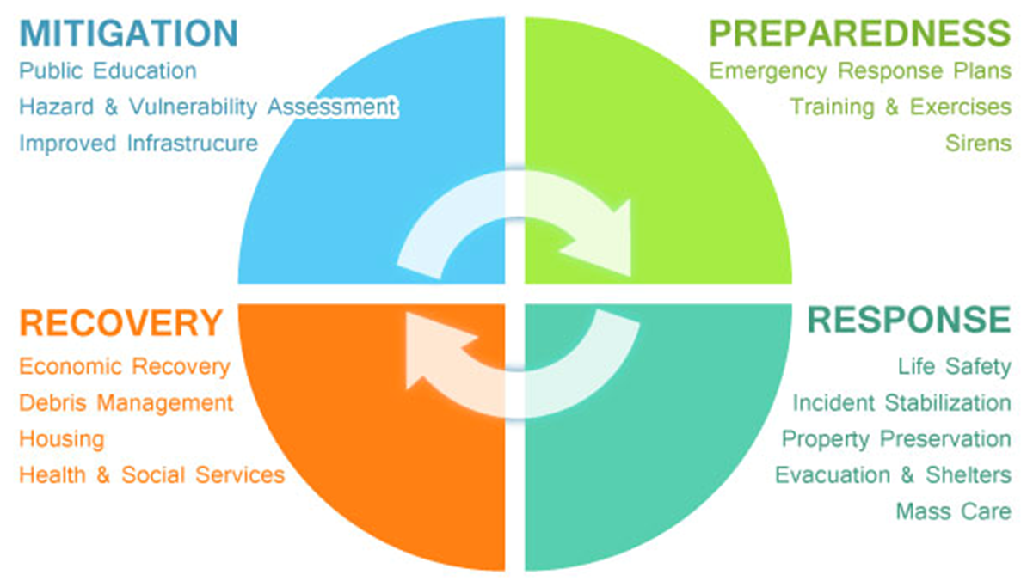
Resiliency Cycle
Notes:
To answer all of the above, we work through a resiliency planning cycle.
The threat, hazard identification and risk assessment process.
Drafted Emergency Plans
Drafted Emergency Response – collaboration and communication when emergency planning turns into response
And Business continuity plans

Slide 9
Recovering from Small and Large Scale Events
Business Unit Continuity Plans
Department Incidences
- Use your plan
- Self managed
- Resources managed
Continuity of Operations
Sizeable Disasters
- University Essential Functions are the priority
- Resource priority
- Managed by Emergency Operation Center
Notes:
While you are working thru this process as a Department…that same process is being done in a university-wide perspective.
So, in a the case of a small scale disaster (building flood) – your Business Continuity Plan will lead the recovery of your Department.
In a large scale disaster – the Essential Functions of the Campus will take priority. The Campus will receive resources first, and a team in the Emergency Operations Center would manage the Campus recovery.

Slide 10
Consistency
Existing UCSC Plans
UC Ready
Emergency Action Plan
UC Ready
Business Continuity Plan
UC Ready User Manual
Building Emergency Coordinator Program
/
Floor Marshals
Notes:
Consistency in resiliency planning is a MUST.
Departments have done fabulous work. Many good plans exist. But within those plans, the Campus does not have a consistent approach. We are using different terminology, we have different protocols and expectations, and that creates a risk to any response or recovery effort.
So, if your department already has any one of these, that’s great, you are ahead of the game, but now we need to roll that plan into a unified process.
The instruments to unifying our processes are here on the screen. Today, we’ll look at two of them, the UC Ready Manual and Resumption Annex and the UC Ready software, and we’ll take a peak at both of these today.
Why the are we doing this, why the change?
Safer – Campus uses Incident Command System, same language, same organizational structure as city, state, and federal emergency responders.
More efficient – collaborative planning formats gives us better assurance of who is covering what (all answering same template, same topics).
Economical impacts – Anytime you have a more efficient process you will save money. Additionally, MOUs and Mutual Aid Agreements increase economic soundness of planning.

Slide 11
Business Continuity Coordinator Role and Responsibilities:
Working with the Office of Emergency Services, the Business Continuity Coordinator (BCC) provides data, analysis and strategy to complete a comprehensive business continuity plan.
Includes examination and identification of: Risks, emergency preparedness protocols, mitigation, essential functions, resumption protocols, resource procurement and assignment, vital records redundancy and protection, equipment, and recovery projections.
A BCC should possess a broad knowledge of the operations and individuals within the Department. They will have access and authority to collect the information necessary to build a comprehensive continuity plan.

Slide 12
Business Continuity Coordinator Continued Processes:
Distribute the plan to employees annually.
When onboarding new employees, share the Department’s business continuity plan.
Train employees and exercise your plan. The Office of Emergency Services can assist with table-top exercises or drills.
Notes:
I know, this sounds like a lot! Don’t be overwhelmed….gather your Department’s stakeholders and form an ad-hoc work group to help YOU!

Slide 13
Identify and Prioritize Essential Functions
ESSENTAL FUNCTIONS : are those organizational operations that are critical to the sustainability of the institution. They are required to be performed during and following a disruption to provide safety and health to the business community, to continue vital services, maintain compliance, preserve research and resources, and sustain the economic base of the institution.
Notes:
An essential Functions is an operational capability that is critical to the sustainability of your institution.
Examples: Payroll, Cruz Alert
Your stakeholders may need to weigh in to create a FULL LIST of Essential Functions.
What are some of the essential functions of your Departments?
Look at Annex Tab 4 – Notice fields
Once you have entered your Essential Functions list, walk through the survey questions to prioritize them. The far right column will score the Essential Functions. SORT the scoring column to establish our prioritized list.
TAB 4 - SORT this data, because…
These fields will auto populate other tabs in the Resumption Annex so please do not overwrite any peach cells.

Slide 14
Notes:
You may tier your Essential Functions…
Continuity of Operations Planning is meant to help the Campus recover from a sizeable disaster or large-scale events:
Same process for the enterprise wide campus continuity of operations plan. Know, your Department’s Plans feed up to this plan.
I share this important side bar, because the onus is really on your team to steer the recovery effort in isolated events. And, in large scale events, to understand the University Essential Functions will take precedence.

Slide 15
Phase I: Threat, Hazards Identification and Risk Assessment
Threats
Cyber attack
Hazards
Earthquake
Fire
Risks
Data loss
Data Breach
Chemical
Building security
Reputation
Explosion
Utility failure
Violent intruder
Notes:
Let’s talk THIRA…
Now that we are past consistency, let’s move into Phase 1 of your business continuity process. In 2005 the University of California conducted a risk assessment of all the campuses. They determined the top risks for each. Anyone want to guess what they included in our top 5 risks?
1. Catastrophic earthquake
2. Lab building fire
3. Power failure
4. Public health emergency
5. And Residential building fire
SHOW : Please open Tab 3 in the Resumption Annex: In the lower half of this annex you and your Department leaders will discuss the risks specific to your department and enter them into the spreadsheet. (e.g. data loss (no server, security risks –doors left unlocked - theft…)
RANK and Sort these Risks.

Slide 16
Phase I: Mitigate
Cyber Attack
Employee training
Earthquake
IIPP- Injury and Illness Prevention Program
Data Breach
Department policy
Building security assessment
Building Emergency Coordinator Program
Secure objects
Emergency Action Plan
Train
Encrypt computers
Procedures
Employee training
Audit operations
Compliance with data protections acts
Written protocols for data security
Test processes
Notes:
Turn to Annex Tab 4: Your “hazards and threats” will prepopulate.
With your risks identified, you have to ask: What is our Department’s appetite for these risks? Then choose your path. Which risks can we accept, which ones must we mitigate (if possible), and which ones are unacceptable? Tailor mitigation and business continuity plan around these risks.
EXAMPLE: In the Office of Emergency Services employees are NOT entering their work on any sort of network….not Google docs, not Amazon, not on a network drive…..employees are simply working on the own hard drives within their laptops. This is a huge risk for business recovery. Mitigation may include a request to IT to establish a server, it may be the addition of a mandatory department protocol that all work be saved in Google Docs, or even the purchase of external hard drives (not ideal).
Whatever the option taken, if the solution FIXED the risk, the Department can now eliminate this risk from business continuity planning. They will always have access to redundant data.

Slide 17
Phase I: Consequences
Cyber Attack
Network access lost
Earthquake
Personal injury
Staff shortages
Data Breach
Revenue lost
Research lost
Compliance not met
Revenue lost
Work obstructions
Reputational damage
Research or agreement violated
Personal information stolen
Legal action
Files infected and inaccessible
Legal action
Financial loss
Loss of business contract
Reputational damage
Notes:
This process for identification of threats, hazards, and risks and your mitigation efforts will be covered in Tab(s) 3-4 of your Annex. We will go over this is more detail shortly.
Putting those threats, hazards, and risks into context you can see that there is the potential for a lot of bad consequences from unmanaged risks.
But, you’ve mitigated wherever possible, so now you can plan your Department’s business recovery. This is known as targeting. You will pair up a risk to an essential function performed by your Department…

Slide 18
Risk – Essential Function Example
Hazards & Threats: Risks
Electrical power outage.
Essential Function #1 (EF#1)
Provide Emergency Alert notifications to the Campus
Effects (what threat means to EF#1)
Mitigation of Hazard
Move operations to EOC for redundant power system (EOC on generator).
Resumption Plan for EF#1
Standard Emergency phone messageing disrupted.
Carriage House unusable (OES Office).
Landline backup phones, cell phone messaging (if cell tower operational), satellite phones for EOC, radios and ham radios, campus e-mail and VOIP alerts.
Impact to Essential Function
Emergency messaging may be delayed, brief (132 text characters) and not everyone has a cell phone.
Notes:
Example of Risk Targeting

Slide 19
Exercise – Risk Targeting
Hazards & Threats: Risks
Essential Fuction #1 (EF#1)
Effects (what threat means to EF#1)
Mitigation of Hazard
Resumption Plan for EF#1
How will this hazard alter the delivery of EF#1?
How will EF#1 be performed under these circumstances?
Impact to Essential Function
What are the upstream/downstream and internal impacts?
Notes:
Exercise: Have BCC practice Risk Targeting for one of their Department’s Essential Functions.

Slide 20
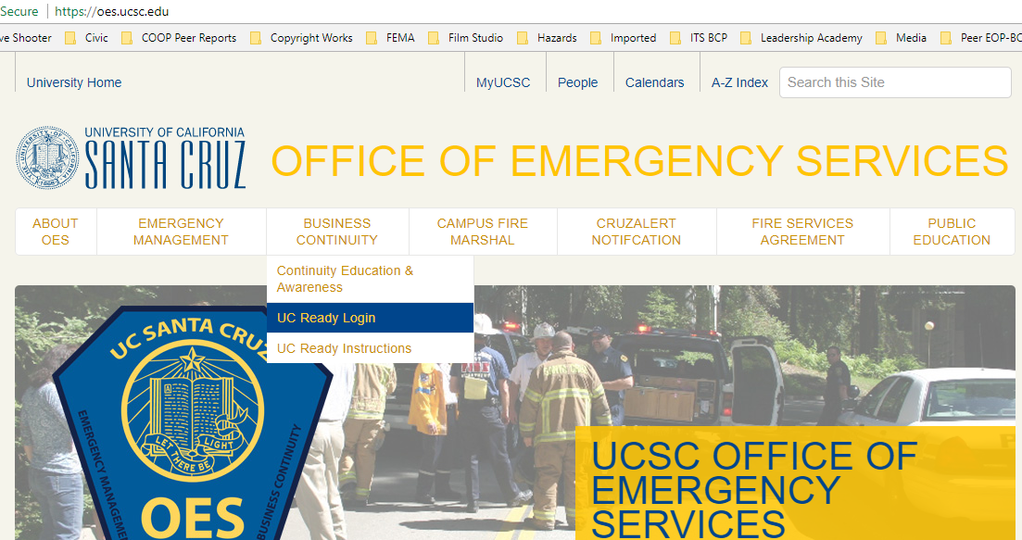
Login to UC Ready: https://oes.ucsc.edu/
https://oes.ucsc.edu/
Notes:
https://oes.ucsc.edu/

Slide 21
1. PLANS
2. GO
3. Locate plan, select EDIT
To Locate and Open Your Plan
Notes:
https://oes.ucsc.edu/

Slide 22
Exercise: Test Drive UC Ready
Login or refresh
Complete entries on PLAN home page
Essential Function Assessment
Notes:
Find your Essential Functions 1 - 10

Slide 23
Two Methods for Data Entry
1. Direct entries in UC Ready in “EDIT” mode
2. Pairing from plan home page
*Hands on – Essential Functions
*Hands on - Pairing
Notes:
Find your Essential Functions 1 - 10

Slide 24
Next Steps
Determine if your Department plan requires stakeholder input. If yes, form your team.
Determine risks and priority essential functions.
Collect and enter necessary data into UC Ready.
Sign-up for UC Ready: Level 2!

Slide 25

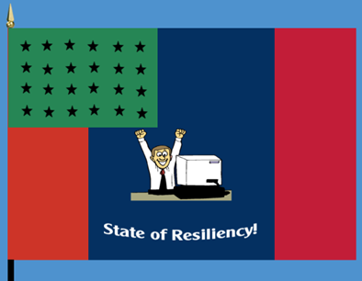
Questions?
Notes:
CONGRATULATIONS!!! You’ve made it and you’re on your way to a “State of Resiliency”!!!

Slide 26
Contact Information for Questions or Assistance:
Stephan Edgar, Campus Business Continuity Planner
E-mail: sedgar@ucsc.edu
Phone: 831-459-3828

