Slide 1
UC Ready
Level 2: Mitigation, Preparedness, Response and Recovery
UC Santa Cruz, Office of Emergency Services

Slide 2
Welcome UCSC Business Continuity Coordinators!
On behalf of the faculty, staff, students and visitors, THANK YOU for your continued service in assuming this role!

Slide 3
UC Ready: Level 2 Overview
Review of key terminology
Business Continuity Coordinator toolkit
Threats, hazards and risks
Essential functions
Effects of risks to essential functions
Mitigation of risks
Maintaining essential functions
Business impact analysis
Recovery and resumption
Notes:
This is an overview of the topics that will be covered in today’s training.

Slide 4
Terminology
Business Continuity: “The process of ensuring that your critical business functions are prepared to react to and recover from a business disruption with minimal amount of impact to your business.” Iowa University.
Risk: An organization’s vulnerability to hazards, including natural disasters and human-caused incidents that pose a threat to facilities or personnel.
Essential Functions: Are those organizational operations that are critical to the sustainability of the institution. They are required to be performed during and following a disruption to provide safety to the health to the business community, to continue vital services, maintain compliance, preserve research and resources, and sustain the economic base of the institution.
Mitigation: Eliminating or minimizing hazards that may result in a major emergency.
Recovery: Returning to a level of normalcy after an emergency has occurred.
Business Resumption: Addresses restoration of your business after an emergency and focuses on preventative measures.
Notes:
Key Terms defined – have members read aloud each term.

Slide 5
Threats, Hazards and Risks…Oh my!!!
Earthquake:
Notes:
In 2005 the University of California conducted a risk assessment of all the campuses. They determined the top risks for each. Anyone want to guess what they included in our top 5 risks?
1. Catastrophic earthquake
2. Lab building fire
3. Power failure
4. Public health emergency
5. And Residential building fire

Slide 6
Threats, Hazards and Risks…Oh my!!!
Wildland Fire:

Slide 7
Threats, Hazards and Risks…Oh my!!!
Power Failure:

Slide 8
Mitigation of Threats, Hazards, and Risks
Hazard
Mitigation(s)
IIPP- Injury and Illness Prevention Program
Consequence(s)
Personal injury
Building Emergency Coordinator Program
Secure objects
Emergency Action Plan
Train
Earthquake
Staff shortages
Research lost
Work obstructions
Compliance not met
Revenue lost
Notes:
This process for identification of threats, hazards, and risks and your mitigation efforts will be covered in Tab(s) 3-4 of your Annex. We will go over this is more detail shortly.
Putting those threats, hazards, and risks into context you can see that there is the potential for a lot of bad consequences from unmanaged risks.
But, you’ve mitigated wherever possible, so now you can plan your Department’s business recovery. This is known as targeting. You will pair up a risk to an essential function performed by your Department…
We’ll come back to this after we talk a bit more about Essential Functions.

Slide 9
Not to worry, YOU have a plan…
Notes:
There is light at the end of the tunnel!

Slide 10
Risk – Essential Function (OES Example)
Hazards & Threats: Risks
Electrical power outage.
Essential Function #1 (EF#1)
Provide Emergency Alert notifications to the Campus
Effects (what threat means to EF#1)
Mitigation of Hazard
Move operations to EOC for redundant power system (EOC on generator).
Resumption Plan for EF#1
Standard Emergency phone messageing disrupted.
Carriage House unusable (OES Office).
Landline backup phones, cell phone messaging (if cell tower operational), satellite phones for EOC, radios and ham radios, campus e-mail and VOIP alerts.
Impact to Essential Function
Emergency messaging may be delayed, brief (132 text characters) and not everyone has a cell phone.
Notes:
Example of Risk Targeting

Slide 11
Exercise – Risk Targeting
Hazards & Threats: Risks
Essential Fuction #1 (EF#1)
Effects (what threat means to EF#1)
Mitigation of Hazard
Resumption Plan for EF#1
How will this hazard alter the delivery of EF#1?
How will EF#1 be performed under these circumstances?
Impact to Essential Function
What are the upstream/downstream and internal impacts?
Notes:
Exercise: Have BCC practice Risk Targeting for one of their Department’s Essential Functions.

Slide 12
Identify and Prioritize Essential Functions
ESSENTIAL FUNCTIONS : Are those organizational operations that are critical to the sustainability of the institution. They are required to be performed during and following a disruption to provide safety and health to the business community, to continue vital services, maintain compliance, preserve research and resources, and sustain the economic base of the institution.
Objective
List Essential Functions
Prioritize Essential Functions
Notes:
Have member read the definition of “Essential Function.”
Examples of possible Essential Functions: Payroll, Cruz Alert
Your stakeholders may need to weigh in to create a FULL LIST of Essential Functions.
What are some of the essential functions of your Departments?
**Refer to your Department’s Mission Statement or Job Descriptions to help in guiding you to determining essential functions.**
SHOW ANNEX TAB 5.

Slide 13
Continuity Planning Process
Business Impact Analysis
Recovery Strategies
Systematic process to determine and evaluate the potential effects of an interruption to critical business operations.
Identify and document methods for returning to normal operations and reinforce validated controls which are already in place

Slide 14
Essential Function Impact Rating Questions
Based on the assumption that the function is unable to be performed
The purpose of the impact ratings is to assess impacts over time
1 Day
3 Days
1 Week
1 Month

Slide 15
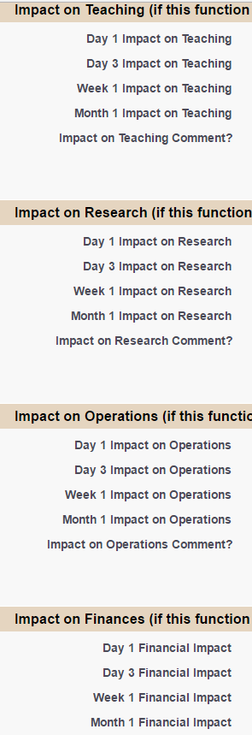
Impact Areas
Teaching
Research
Operations
Finance
Compliance

Slide 16
Impact Options
No Impact
Minimal on coursework and/or student degree progress
Significant on coursework and/or student degree progress
Severe on coursework and/or student degree progress

Slide 17
Tolerance, Impact, Support

Slide 18
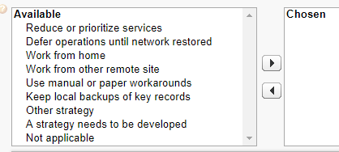
Recovery Strategies
Loss of IT Network/Server
Loss of Normal Workspace
Loss of Key Personnel/Campus Operating Status

Slide 19
Strategies and Assumptions
Strategy | Assumptions
Loss of IT Network | Identify work that can be completed manually or has a local drive to access. Identify processes to defer until IT systems are reestablished. Detail use of IT systems will assist IET in backup and recovery strategies.
Loss of Normal Workspace | Plan for 5 to 7 Days not being in your normal workspace. The Assumption is that the an alternate temporary or permanent workspace will be identified within that time period. Include campus closure in this section. Plan for the campus operations to be reduced, suspended or closed for 7 days. Plan for a disruption curriculum activity for 5 to 7 Days. The assumption is that the curriculum end period will not change. Plan for disruption of research activity for 5 to 7 Days. Strategies/contracts should be developed based on the uniqueness of the type of research.
Loss of Key Personnel | Plan for a 33% absentee rate. Identify designated employees that will be called upon to perform essential functions. Employee designations may change depending on the type of emergency or its duration. Clarify roles and expectations of non-designated employees who may be asked to work remotely.

Slide 20
Recovery
During a large scale disaster, the recovery effort will be led by the Emergency Operations Center (EOC) Team. It is important that your Department liaisons work closely with the EOC to ensure efficient and economically sound recovery.
In some instances you may have to resume operations at an alternative site.
If you need to re-enter a structure to recover equipment and files, you must wait until the building inspection process has been completed.
Notes:
Read each bullet point.

Slide 21
Recovery Continued…
Large scale disaster recoveries will be coordinated by the EOC. Small, single Department damaging events should be coordinated with campus service officers (areas related) and the affected Department(s).

Slide 22
Next Steps… Include this in your Plan!
Phone Tree
Leadership
Communication Liaison
Department Roster and Evacuation Roles

Slide 23
Next Steps… Maintaining Your Plan
Review and update your plan(s)
Plan IT information
EF IT strategies, applications/services (include MTD, MTDL, explanations)
Contact me:
Report Campus Essential Functions
IT Applications not listed
Questions
Attend Continuity Workshops!

Slide 24
…with YOUR plan your Department is on it’s way to the road of recovery and resumption
Notes:
I know this may seem like a daunting task. Rome was not built in a day and we do not expect you to build a business continuity plan for your Department in a day! Set realistic goals for yourself, such as completing one tab a week in the Resumption Annex.
Always remember, that if you run into any questions or concerns during you planning process that the Office of Emergency Services is always here to assist you along the way.

Slide 25
Questions?
Notes:
CONGRATULATIONS!!! You’ve made it and you’re on your way to a “State of Resiliency”!!!

Slide 26
Contact Information for Questions or Assistance:
Stephan Edgar, Campus Business Continuity Planner
E-mail: sedgar@ucsc.edu
Phone: 831-459-2342

